Slide 1
Database Design
Two Approaches (Techniques) to Database Design
Data Modeling
A conceptual picture of your database
Drawn with a computer-based tool
Normalization
A method of cleaning up and organizing your data
Structures the data to fit the RELATIONAL MODEL
A set of rules you apply to the data to clean up the data

Slide 2
Database Design
Best Approach
Combine the Two
We construct a data model
We normalize the data as we model
Iterative process
Model some, normalize some
Model some more, normalize some more
BUT, we must FIRST learn the process of Normalization

Slide 3
Database Design
Normalization
A structured, defined, detailed process
Prepares data to make sure it complies with the rules of the RELATIONAL MODEL
Often seen by students as a CONFUSING process
Concepts are somewhat ACADEMIC and THEORETICAL

Slide 4
Database Design
Normalization:
A bag of unorganized data

Slide 5
Normalization
Objective of Normalization
To Arrange the data into a series of clearly defined, well-organized RELATIONS
Each with a primary key
All attributes are functionally dependent on the primary key
Each with required foreign keys referencing other relations

Slide 6
Normalization
Normalization: follow the Rules of “ONE”
One entity = one table
One occurrence of that entity = one row
One attribute = one column
All columns in the row describe one occurrence of that entity
All columns are functionally dependent on one primary key

Slide 7
Normalization
Normalization: Rules of “ONE” EXAMPLE
Imagine a system used by a university’s Registrar’s office
We keep data about STUDENTS (entity)
For a student (one occurrence of the entity) we store FirstName, LastName, MiddleInitial, PhoneNumber, Address (attributes)
We identify a student by their StudentID (primary key)

Slide 8
Normalization
Entity = STUDENT
Attributes = (StudentID, FirstName, LastName, MiddleInitial, PhoneNumber, Address)
One entity, one primary key, one student contained in one row, all columns are functionally dependent on the one primary key

Slide 9
Normalization
How do we achieve this?
Key Analysis using Functional Dependencies
Identify and correct anomalies
Decomposition of a single table into multiple tables

Slide 10
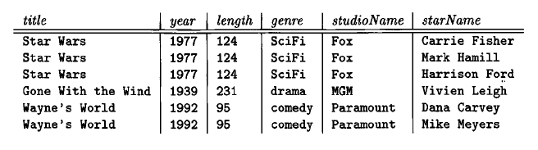
Normalization
Anomalies
Redundancy – storing a piece of data more than once
Update/Delete errors

Slide 11
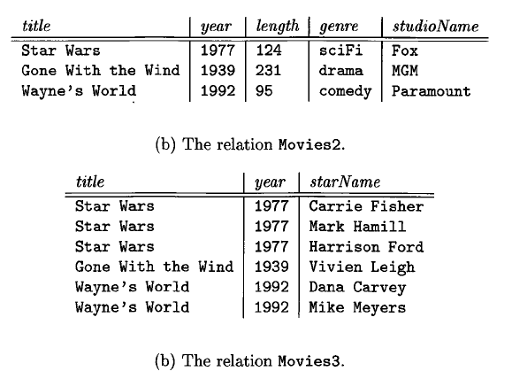
Normalization
Decomposing this relation into two removes the anomalies

Slide 12
Normalization
Normalization Step-by-Step
First Normal Form
Remove any multi-valued cells and/or any rows requiring a specific sequence
Second Normal Form
For entities with concatenated keys, make sure that all attributes are dependent on the full key
Third Normal Form
Make sure that no attributes are dependent on any other non-key attributes
Fourth Normal Form
Eliminate multi-value dependencies

Slide 13
Normalization
First Normal Form
Remove Repeating Groups of attributes
Put repeating attributes into a new relation
Create a key for the new relation
Probably a Concatenated key
The key of the Original relation + an identifier for each occurrence of the Repeating Group of attributes

Slide 14
Normalization
Second Normal Form
Every non-key attribute is functionally dependent on the entire primary key
Only meaningful when there is a concatenated key
Create a new relation
Create a key for the new relation
Migrate only the dependent columns to the new relation

Slide 15
Normalization
Third Normal Form
No non-key attributes are dependent on any other non-key attributes
Create a new relation
Create a key for the new relation
Migrate only the dependent columns to the new relation

Slide 16
Normalization
Fourth Normal Form
A multi-valued dependency is this:
Multiple independent attributes are dependent on the same determinant
Example:
One Customer may have multiple “contacts” of different “types”

Slide 17
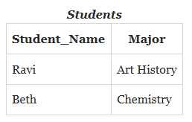
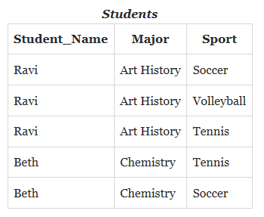
Normalization
Multivalued Dependency example

Slide 18
Normalization
Introduces anomalies
Major and Sport both are FD on Student_Name, but are independent of each other.

Slide 19
Normalization
Let’s work through some examples
As you are designing a database, you must define your clients’ DATA REQUIREMENTS
During interviews, Clients often refer you to their existing reports, spreadsheets, screens, etc.
So, let’s think about FDs visible in this data
Think about Primary Keys
Determine which attributes are dependent on which primary keys

Slide 20
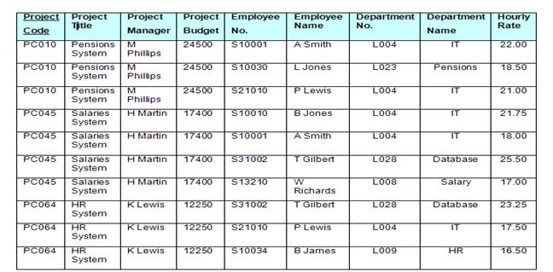
Normalize This
More practice

Slide 21
Normalization
Another example:
Imagine you are a consultant hired to design a database for a furniture manufacturer
In defining requirements, you were given a sample customer invoice document
Your task is to NORMALIZE this data

Slide 22
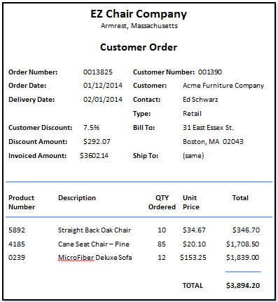
Normalization

Slide 23
Normalization
Steps:
List all entities and attributes in UNNORMALIZED form
Then, put the data into First, Second, Third normal forms, following the rules:

Slide 24
Normalization
Normalization Step-by-Step
First Normal Form
Break out any multi-valued/repeating values and/or any values requiring a specific sequence
Second Normal Form
Only for entities with concatenated keys: identify and break out any attributes dependent on a part of the concatenated key
Third Normal Form
Identify and break out any attributes that are dependent on any other non-key attributes

Slide 25
Un-Normalized
UNNORMALIZED
Customer Order
Order Number
Order Date
Delivery Date
Customer Discount
discount amount
invoiced amount
customer number
customer name
Contact
ContactType
bill to address
bill to city
bill to state
bill to zip
ship to address
ship to city
ship to state
ship to zip
Product Number
Description
quantity ordered
unit price
order total
} Repeating/Multi-valued

Slide 26
Normalization

Slide 27
1st NF
UNNORMALIZED
Customer Order
Order Number
Order Date
Delivery Date
Customer Discount
discount amount
invoiced amount
customer number
customer name
Contact
ContactType
bill to address
bill to city
bill to state
bill to zip
ship to address
ship to city
ship to state
ship to zip
Product Number
Description
quantity ordered
unit price
order total
FIRST NORMAL FORM
Customer Order
Order Number
Order Date
Delivery Date
Customer Discount
discount amount
invoiced amount
customer number
customer name
Contact
ContactType
bill to address
bill to city
bill to state
bill to zip
ship to address
ship to city
ship to state
ship to zip
order total
OrderProduct
Order number
Product Number
Product Description
Quantity
unit price
➔

Slide 28
Normalization

Slide 29
2nd NF
FIRST NORMAL FORM
Customer Order
Order Number
Order Date
Delivery Date
Customer Discount
discount amount
invoiced amount
customer number
customer name
Contact
ContactType
bill to address
bill to city
bill to state
bill to zip
ship to address
ship to city
ship to state
ship to zip
order total
OrderProduct
Order number
Product Number
Product Description
Quantity
unit price
Customer Order
Order Number
Order Date
Delivery Date
Customer Discount
discount amount
invoiced amount
customer number
customer name
Contact
ContactType
bill to address
bill to city
bill to state
bill to zip
ship to address
ship to city
ship to state
ship to zip
order total
➔
OrderProduct
Order number
Product Number
Quantity
unit price
total
Product
Product Number
Product Description
➔

Slide 30
Normalization

Slide 31
3rd NF
SECOND NORMAL FORM
THIRD NORMAL FORM
Customer Order
Order Number
Order Date
Delivery Date
Customer Discount
discount amount
invoiced amount
customer number
customer name
Contact
ContactType
bill to address
bill to city
bill to state
bill to zip
ship to address
ship to city
ship to state
ship to zip
order total
Order
Order Number
Order Date
Delivery Date
discount amount
invoiced amount
customer number
order total
Customer
customer number
customer name
Contact
ContactType
bill to address
bill to city
bill to state
bill to zip
ship to address
ship to city
ship to state
ship to zip
➔
OrderProduct
Order number
Product Number
Quantity
unit price
total
Product
Product Number
Product Description
OrderProduct
Order number
Product Number
Quantity
unit price
total
Product
Product Number
Product Description
➔

